Slide 1
UNIT – 3 Part II Loops
Programming in C (COM412)
BSc CSIT First Semester
Mid-West University
Birendranagar, Surkhet, Nepal
Prepared by:
Dabbal Singh Mahara
Asst. Prof.
2023

Slide 2
Loop or Iterative Statements
Loop is defined as a block of statements which are repeatedly executed for a certain number of times till a particular condition is satisfied.
When the condition becomes false, the loop terminates and the control is passed to the statement immediately following the loop.
A loop consists of two segments: control statement and body of the loop.
The control statement in loop decides whether the body is to be executed or not.

Slide 3
Entry Controlled and Exit Controlled loop
Depending on the position of the test condition in the loop, a loop may be classified either as the entry controlled loop or exit controlled loop.
In the entry controlled loops, conditions are tested before the start of the loop execution. If the conditions are satisfied, then the body of the loop will be executed.
while loop and for loop are examples of entry controlled loop.
In the case of an exit-controlled loop, the test is performed at the end of the body of the loop execution. If the conditions are not satisfied, then the body of the loop will not be executed.
Do While loop is an example of Exit controlled loop.

Slide 4
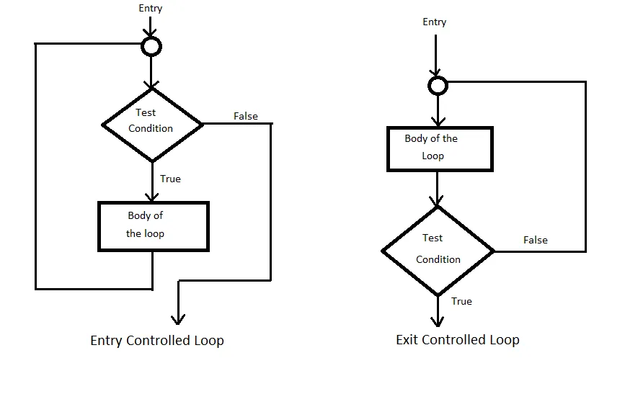
Entry Controlled and Exit Controlled loop

Slide 5
Types of loop
for loop
while loop
do while loop

Slide 6
for loop
When the number of repetitions is known in advance, the use of this loop is more efficient and so is also called determinate or definite loop.
The general syntax is:
for(initialization; test condition; increment or decrement)
{
statement(s); //body of the loop
}

Slide 7
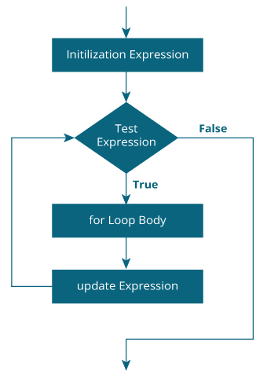
Flow Chart of for loop

Slide 8
How for loop works?
The initialization expression is executed only once.
Then, the test expression is evaluated. If the test expression is evaluated to false, the for loop is terminated.
However, if the test expression is evaluated to true, statements inside the body of the for loop are executed, and the update expression is updated.
Again the test expression is evaluated.
This process goes on until the test expression is false. When the test expression is false, the loop terminates.

Slide 9
Example : for loop
// Displaying your name and country 10 times each
#include <stdio.h>
#include <conio.h>
int main()
{
int i;
for(i=0; i<10; i++)
{
printf("\n My name is Prabin Kumar.");
printf(“\n I live in Nepal.”)
}
getch();
return o;
}

Slide 10
Example: 2 Printing Multiplication Table
//Multiplication table
#include <stdio.h>
#include <conio.h>
int main()
{
int n,t;
printf(“Enter a number” );
scanf(“%d”,&n);
for(j=1;j<=10;j++)
{
t = n *i;
printf("%d * %d = %d\n",n,i,t);
}
getch();
return 0;
}

Slide 11
Practice Time
Write a program to read an integer number n from keyboard and display the message “Get Well Soon” n times.
Write a program to calculate the factorial of a number using for loop.
Write a program that asks an integer number n and calculate sum of all natural numbers from 1 to n.
Compute 1²+2²+3²+…+n² using for loop (Take n from user).

Slide 12
while loop
The syntax is:
initialization
while(test condition)
{
body of loop;
}
The test condition is evaluated at first and if the condition is true, then the body of the loop is executed.
After execution of the body once, the test condition is again evaluated and if it is true, the body is executed once again.
This process repeats until the test condition finally becomes false and then the control is transferred out of the loop to the statement immediately following the loop.

Slide 13
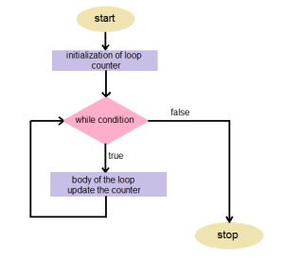
Flowchart
Flow Chart of while loop

Slide 14
Example: while loop
// Print numbers from 1 to 5
#include <stdio.h>
int main() {
int i = 1;
while (i <= 5)
{
printf("%d\n", i);
++i;
}
return 0;
}

Slide 15
do while loop
The syntax is:
do
{
statement(s) or body of loop;
} while(test condition);
In do while loop, the body of the loop is executed at first without testing the condition.
At the end of the loop, test condition is evaluated and if the condition is true, the body is executed; otherwise the loop gets terminated and control is passed to the statement immediately following the loop.
Important to Note: The body of the loop is executed at least once in a do while loop regardless of the test condition.

Slide 16
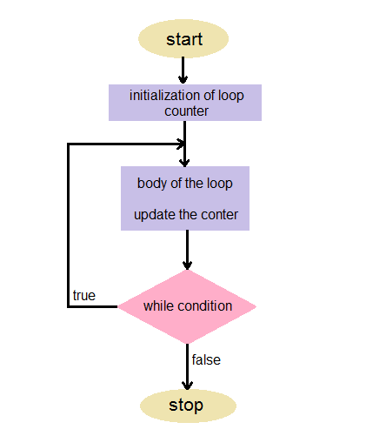
Flowchart of do while loop

Slide 17
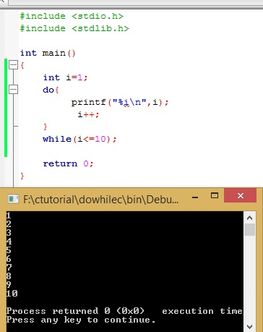
Example:

Slide 18
Nested Loop
When the body part of a loop contains another loop, then the inner loop is said to be nested within the outer loop.
There is no limit of the number of loops that can be nested.
In case of nested loops, for each value or pass of the outer loop, the inner loop is executed completely. Therefore, inner loop operates fast and outer loop operates slow.

Slide 19
The nested for loop means any type of loop which is defined inside the 'for' loop.
for (initialization; condition; update)
{
for(initialization; condition; update)
{
// inner loop statements.
}
// outer loop statements.
}
Nested Loop

Slide 20
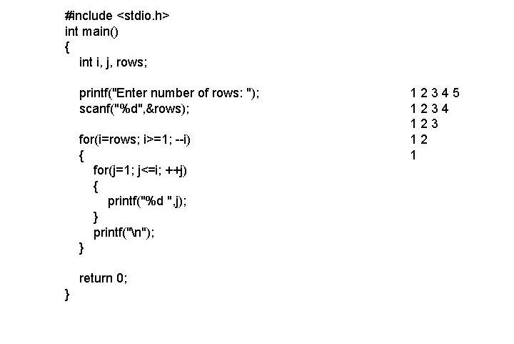
Example: Nested Loop

Slide 21
break, continue, return and exit
break - The break statement is used to jump out of loop. After the break statement control passes to the immediate statement after the loop. continue - Using continue we can go to the next iteration in loop.
return - Exits the function. exit - It is used to exit the execution of program. note: break and continue are statements, exit is function.

Slide 22
break Statement
The break statement terminates the execution of the loop and the control is transferred to the statement immediately following the loop.
As we know, a loop is terminated when its condition becomes false, however if we have to terminate the loop without testing loop the termination condition, then break statement is useful.
Syntax:
break;

Slide 23
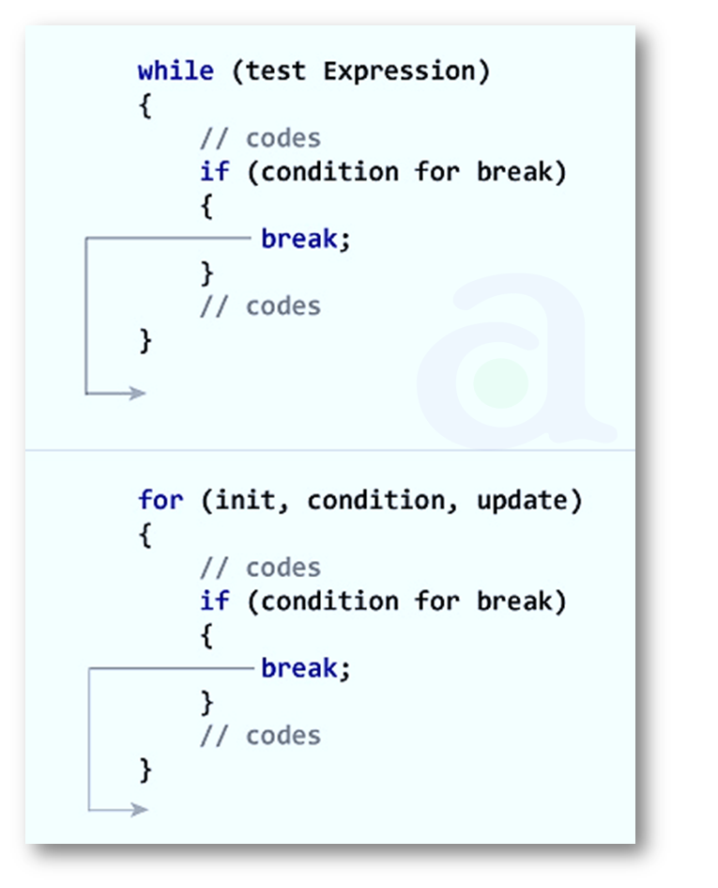
break statement

Slide 24
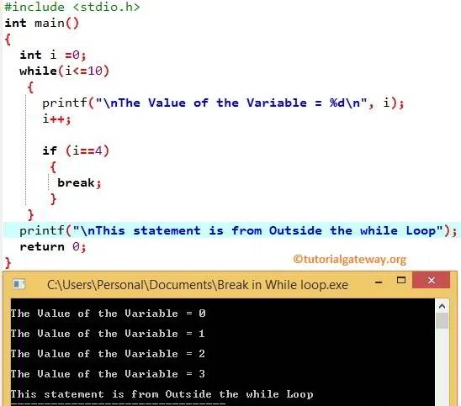
Example: break statement

Slide 25
// Program to test whether an entered number is prime or not
#include <stdio.h>
#include <conio.h>
main()
{
int i,num;
printf("\nEnter a number:");
scanf("%d",&num);
for(i=2;i<num;i++)
{
if(num%i==0)
{
printf("\nNot Prime.");
break;
}
}
if(i==num)
{
printf("\nPrime Number.");
}
getch();
}

Slide 26
continue Statement
The continue statement is used to bypass the remainder of the current pass through the loop.
The loop does not terminate when a continue statement is encountered.
“SKIP THE FOLLOWING STATEMENTS AND CONTINUE WITH THE NEXT ITERATION”
Syntax:
continue;

Slide 27
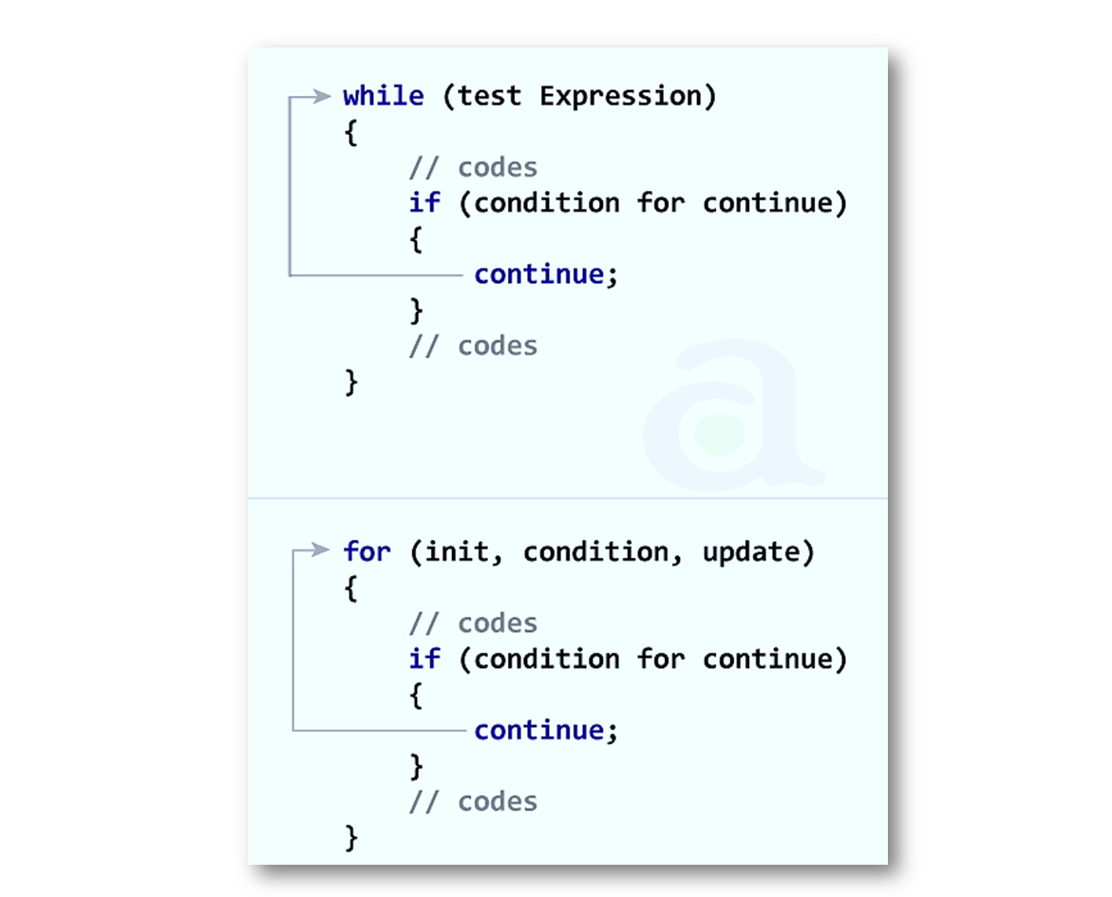
continue Statement

Slide 28
#include <stdio.h>
#include <conio.h>
int main()
{
int i, num;
printf("\nEnter a number:");
scanf("%d", &num);
printf("\nThe even numbers from 2 to %d are:\n", num);
for(i=1;i<=num;i++)
{
if(i%2!=0)
{
continue;
}
printf("%d\t", i);
}
getch();
}

Slide 29
goto Statement
The goto statement is used to alter the normal sequence of program execution by unconditionally transferring control to some other part of the program.
The goto statement transfers the control to a labeled statement somewhere in the current function using syntax:
goto label;
Here, label is an identifier used to label the target statement to which the control would be transferred.
The target statement must be labeled using syntax:
label: statements;

Slide 30
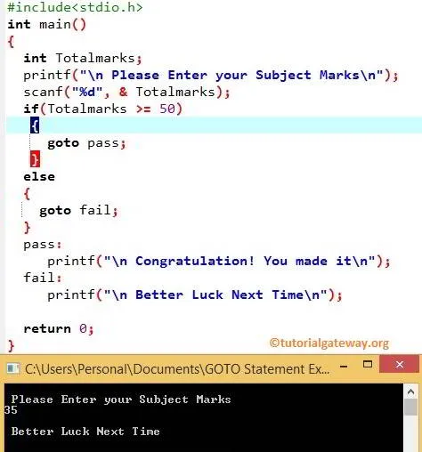
Example goto statement

Slide 31
// Program for Armstrong number
Int main()
{
int num,digit,sum=0;
int temp;
printf("\nEnter number to be checked:\t");
scanf("%d", &num);
temp=num;
while(num!=0)
{
digit = num % 10;
sum += digit*digit*digit;
num /= 10;
}
if(temp==sum)
printf("\nArmstrong Number!!!");
else
printf("Not Armstrong Number.");
getch();
return 0;
}

Slide 32
//Program for reversing a number
int main()
{
int n, digit;
printf("\n Enter number you want to reverse:");
scanf("%d", &n);
printf("\n The reverse of the entered number is:");
while(n!=0)
{
digit=n%10;
printf("%d", digit);
n=n/10;
}
getch();
return 0;
}

Slide 33
//Program to compute sum of digits of an integer
#include <stdio.h>
#include <conio.h>
int main()
{
int num, rem, q, sum=0;
printf("\nEnter number to be checked:\t");
scanf("%d", &num);
do
{
q = num / 10;
rem = num % 10;
num = q;
sum += rem;
}while(q!=0);
printf("\nThe sum of digits is:\t%d", sum);
getch();
return 0;
}

Slide 34
//Program to reverse a number
int main()
{
long int num,rev=0;
int digit;
printf("\nEnter number to be reversed:\t");
scanf("%ld", &num);
while(num!=0)
{
digit = num%10;
rev = rev*10+digit;
num = num/10;
}
printf("\nThe reversed number is:%ld",rev);
getch();
}

Slide 35
/*Program to read a number from keyboard and check whether it is a palindrome or not*/
int main()
{
int num, rev=0, digit, temp;
printf("\nEnter number to be checked:\t");
scanf("%d", &num);
temp = num;
while(num!=0)
{
digit = num%10;
rev = rev*10 + digit;
num = num/10;
}
if(temp==rev)
{
printf("\nThe number is a palindrome");
}
else
{
printf("\nThe number is not a palindrome");
}
getch();
}

Slide 36
//Program to convert decimal no. to binary
int main()
{
long int decnum, binnum, rev=0, q=1, rem, i=1;
printf("\nEnter decimal number:\t");
scanf("%ld", &decnum);
while(q!=0)
{
q = decnum / 2;
rem = decnum % 2;
decnum = q;
rev = rev + rem*i;
i = i * 10;
}
printf("\nThe corresponding binary number is:%ld", rev);
getch();
}

Slide 37
//Fibonacci sequence: 1, 1, 2, 3, 5, 8, 13, 21, 34, 55, 89, …
int main()
{
int a,b ,c, num;
a=1;
b=1;
printf("\nEnter number upto which you want Fibonacci sequence:\t");
scanf("%d", &num);
printf("%d %d”,a,b);
do
{
c = a + b;
a = b;
b = c;
printf(",%d", c);
} while(i<=num);
return 0;
}

Slide 38


